Slide 1

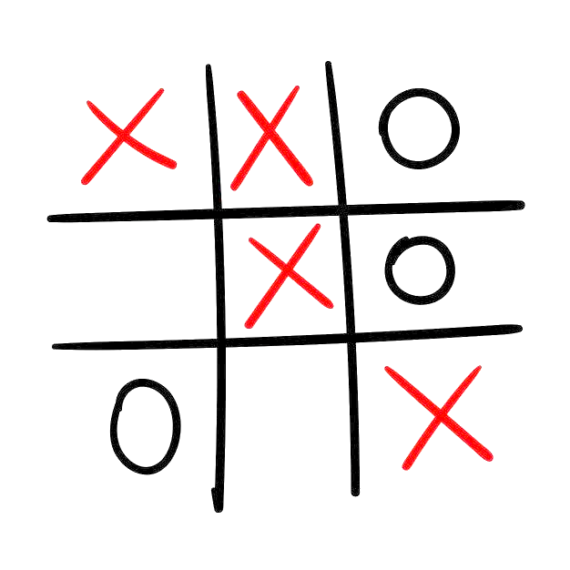
From Random Moves to Optimal Play: Q-Learning in Tic-Tac-Toe
Arshiya naaz (2420080084)
Syed Zuvaria(2420080100)
K.Harini priya(2420080028)

Slide 2
Table of Contents
Introduction
Problem Statement/Abstract
Literature Survey
Datasets Description
Methodology
Results
Visualizations
Conclusions

Slide 3
Introduction
Artificial Intelligence has significantly advanced in recent years, with Reinforcement Learning (RL) emerging as a powerful technique for decision-making problems. Reinforcement Learning enables an agent to learn optimal behavior through interaction with an environment by receiving rewards or penalties based on its actions. Games provide an ideal testing ground for RL algorithms due to their well-defined rules and measurable outcomes.
Tic-Tac-Toe is a simple yet effective environment for demonstrating reinforcement learning concepts. Despite its simplicity, the game requires strategic decision-making, making it suitable for illustrating how an agent learns optimal gameplay through experience rather than predefined rules.

Slide 4
Problem Statement
To design and implement an intelligent Tic-Tac-Toe game agent that learns optimal gameplay strategies using Reinforcement Learning, specifically Q-Learning, through repeated self-play without any hard-coded strategies. Agent creates two winning pathways (forks) while simultaneously maximizing block potential by choosing the board cell with the highest probability-adjusted Q-value. The results show that the agent successfully learns effective strategies and exhibits near-optimal behavior.

Slide 5
Literature Survey
Sno | Title of the Paper | Author | Year of Publishing | Method Used | Limtations of this work
1 | Strategic Implementation of AI for Optimal Gameplay in Tic‑Tac‑Toe | Pranjali Bedre, Sanika Chaudhari, Shrushti Jadhav et al | 20235 | Developed a Python‑based Tic‑Tac‑Toe application with a Tkinter GUI. | The current version is confined to a single 3×3 board, lacks difficulty‑level settings, score tracking, sound effects, and networked/multiplayer capabilities,
2 | Low-Level Learning: A C++ Engine for Foundational AI Techniques | Nick Brenner, Alex Kozik, Kevin Weng | 2025 | The paper presents a low-level AI engine implemented entirely in C++ | The system is evaluated mostly on small-scale and controlled environments.

Slide 6
Sno | Title of the Paper | Author | Year of Publishing | Method Used | Limtations of this work
3 | Real-Time Robotic System for Interactive Tic-Tac-Toe Using Computer Vision. | Ioan-Alexandru Spulber, Mihnea Dimitrie Doloiu | 2025 | The paper presents the design and implementation of a real-time robotic system capable of playing Tic-Tac-Toe against a human opponent. | The system detects only circular (‘O’) symbols and does not fully support recognition of ‘X’ symbols.
4 | Real-Time Robotic System for Interactive Tic-Tac-Toe Using Computer Vision. | Ioan-Alexandru Spulber, | 2025 | The paper presents a real-time robotic Tic-Tac-Toe system using an XY plotter | The system detects only one symbol type, lacks learning or adaptability
5 | Learning from Delayed Rewards – Watkins | Watkins | 1989 | Q-Learning | Slow convergence for large state spaces

Slide 7
Dataset/s Description
This project does not use a traditional dataset. Instead, data is generated dynamically through gameplay interactions.
Attributes
State: Current configuration of the 3×3 Tic-Tac-Toe board
Action: Placement of a mark in an empty cell
Reward:
Win: +1
Loss: −1
Draw: 0
Each game episode contributes to the learning process by updating Q-values based on outcomes.

Slide 8
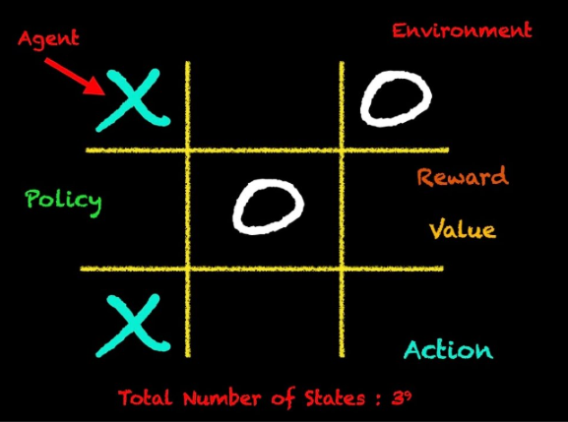
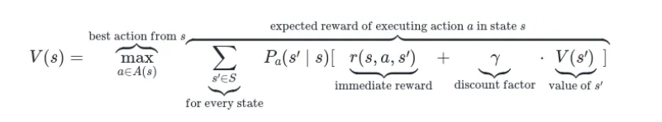
Methodology
The system follows a Reinforcement Learning approach using Q-Learning.
Steps Involved
Initialize Q-table with zero values
Start a new game episode
Select an action using ε-greedy policy
Perform the action and update the board
Receive reward based on game outcome
Update Q-values using the Q-Learning update rule
Repeat for multiple episodes

Slide 9
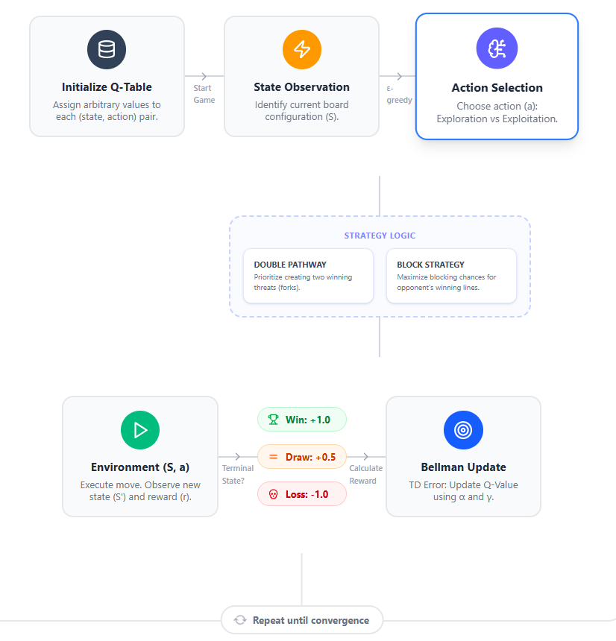

Slide 10
Results and Discussions
After training over thousands of episodes:
The agent learned to prefer center and corner positions
Win rate significantly improved over time
Loss rate decreased drastically
Majority of games ended in wins or draws against random opponents
The trained agent demonstrates intelligent behavior without any predefined strategies.

Slide 11
Visualizations
Heat Map
A heat map was generated to visualize the frequency of moves made by the agent. It shows:
Highest preference for the center cell
Secondary preference for corner cells
Least preference for edge cells
Gameplay Interface
An interactive web interface was developed using HTML, CSS, and JavaScript to demonstrate gameplay between a human and the AI.

Slide 12
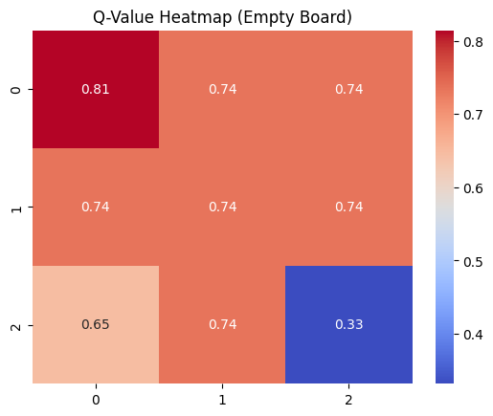
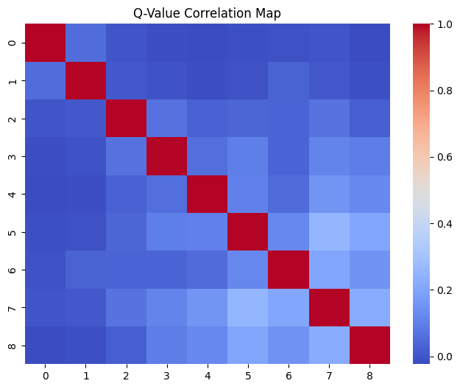
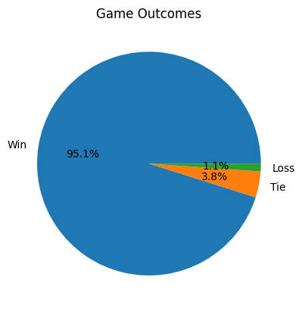
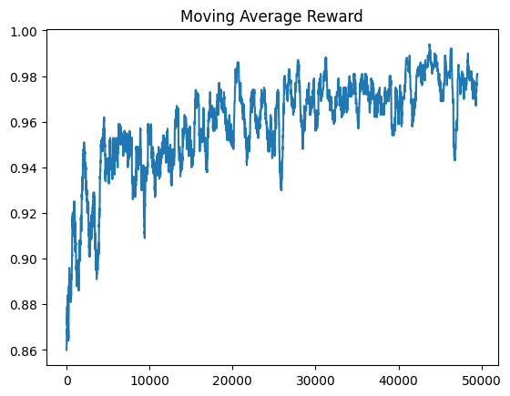
Visualizations

Slide 13
Conclusions
This project successfully demonstrates the application of Reinforcement Learning to a simple game environment. The Q-Learning agent learned optimal strategies through self-play and reward feedback without human intervention. Visual analysis using heat maps confirmed that the learned strategies align with optimal Tic-Tac-Toe gameplay. The project effectively highlights the fundamentals of Reinforcement Learning and its practical implementation.

Slide 14
Pending Taks from Project after Review-1
Sno | Task | Date of Completion

Slide 15
Future Work
Extend to larger grids (4×4 Tic-Tac-Toe)
Try neural function approximation (DQN / Deep Q-Learning)
Include other RL algorithms (SARSA / Monte Carlo)

Slide 16
References
Hoetal. “Reinforcement Learning: Playing Tic-Tac-Toe”, JSR 2023
Wang H. et al. “Monte Carlo Q-learning for GGP”, arXiv 2018
Project GitHub (SARSA/Q-Learning)
Q-learning Tic-Tac-Toe implementation
Q-learning performance study

Slide 17
Thank You

